Slide 1
SQL Keys
An SQL key is either a single column (or attribute) or a group of columns that can uniquely identify rows (or tuples) in a table. SQL keys ensure that there are no rows with duplicate information. Not only that, but they also help in establishing a relationship between multiple tables in the database.

Slide 2
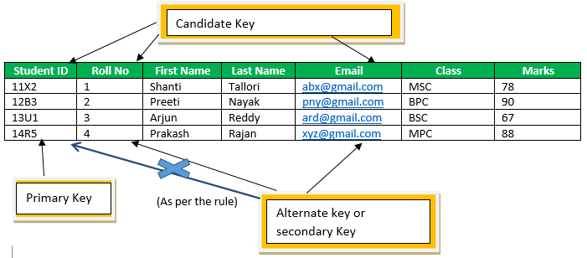
Candidate,primary,alternate keys.

Slide 3
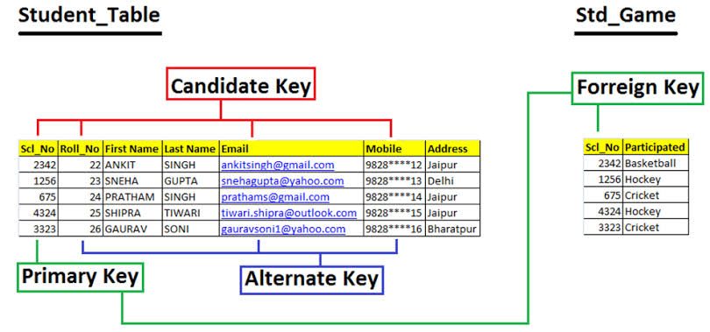
Foreign key example

Slide 4
Candidate key
CANDIDATE KEY in SQL is a set of attributes that uniquely identify tuples in a table. The Primary key should be selected from the candidate keys. Every table must have at least a single candidate key.

Slide 5
The PRIMARY KEY constraint uniquely identifies each record in a table.
Primary keys must contain UNIQUE values, and cannot contain NULL values.
A table can have only ONE primary key; and in the table, this primary key can consist of single or multiple columns (fields).

Slide 6
Alternate key
Alternate keys are those candidate keys which are not the Primary key. There can be only one Primary key for a table. ... They can also uniquely identify tuples in a table, but the database administrator chose a different key as the Primary key.

Slide 7
Foreign key
In the relational databases, a foreign key is a field or a column that is used to establish a link between two tables.
A REFERENTIAL INTEGRITY is a database concept that is used to build and maintain logical relationships between tables to avoid logical corruption of data. ..

Slide 8
Composite key
A composite key in SQL can be defined as a combination of multiple columns, and these columns are used to identify all the rows that are involved uniquely. Even though a single column can't identify any row uniquely, a combination of over one column can uniquely identify any record.

Slide 9
Difference between composite and compound key
A composite key is made up of elements that may or may not be foreign keys.
A compound key is a key whereby any part of the key is a foreign key.

Slide 10
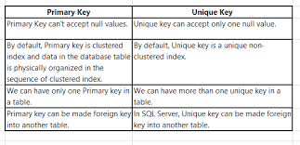
More diifferences

Slide 11
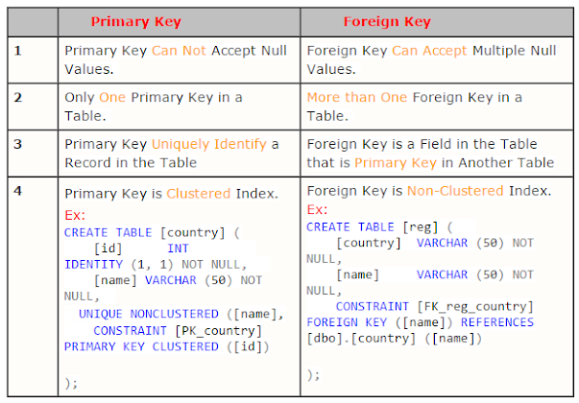

Slide 12
Syntax of creating primary key
MySQL:
CREATE TABLE Persons ( ID int NOT NULL, LastName varchar(255) NOT NULL, FirstName varchar(255), Age int, PRIMARY KEY (ID) );

Slide 13
SQL Server / Oracle / MS Access:
CREATE TABLE Persons ( ID int NOT NULL PRIMARY KEY, LastName varchar(255) NOT NULL, FirstName varchar(255), Age int );

Slide 14
To create a PRIMARY KEY constraint on the "ID" column when the table is already created, use the following SQL:
ALTER TABLE Persons ADD PRIMARY KEY (ID);

Slide 15
Note: If you use ALTER TABLE to add a primary key, the primary key column(s) must have been declared to not contain NULL values (when the table was first created).

Slide 16
DROP a PRIMARY KEY Constraint
alter table tablename drop primary key
alter table emp drop primary key

Slide 17
Syntax to create reference key
MySQL:
CREATE TABLE Orders ( OrderID int NOT NULL, OrderNumber int NOT NULL, PersonID int, PRIMARY KEY (OrderID), FOREIGN KEY (PersonID) REFERENCES Persons(PersonID) );

Slide 18
SQL Server / Oracle / MS Access:
CREATE TABLE Orders ( OrderID int NOT NULL PRIMARY KEY, OrderNumber int NOT NULL, PersonID int references Persons(PersonID) );
Eg-create table stu2(id number references course(id),name varchar(10))

Slide 19
SQL FOREIGN KEY on ALTER TABLE
To create a FOREIGN KEY constraint on the "PersonID" column when the "Orders" table is already created, use the following SQL:
MySQL / SQL Server / Oracle / MS Access:
ALTER TABLE Orders ADD FOREIGN KEY (PersonID) REFERENCES Persons(PersonID);
Eg-alter table student_info1 add foreign key(student_id)references course(id)

Slide 20
Creating foreign key constraint
CREATE TABLE Orders (
OrderID int NOT NULL,
OrderNumber int NOT NULL,
PersonID int,
PRIMARY KEY (OrderID),
CONSTRAINT FK_PersonOrder FOREIGN KEY (PersonID)
REFERENCES course(id)
);

Slide 21
DROP a FOREIGN KEY Constraint
MySQL:
ALTER TABLE Orders DROP FOREIGN KEY FK_PersonOrder;
SQL Server / Oracle / MS Access:
ALTER TABLE Orders DROP CONSTRAINT FK_PersonOrder;

Slide 22
Syntax of creating Composite key
CREATE TABLE SAMPLE_TABLE
(COL1 integer,
COL2 varchar(30),
COL3 varchar(50),
PRIMARY KEY (COL1, COL2));

Slide 23
The rules of Primary Key are as follows:
All the values in the column chosen as the primary key must be unique.
Each and every table can have only one primary key.
No value in the primary key column can be NULL.
You cannot insert a new row with a pre-existing primary key.

